Slide 1

Using Alternate Data sources to Drive Investment Decisions

Slide 2
Agenda
1
Business Context
2
Alternative Data Stack to measure Business performance
3
Stock Scoring Approach
4
Sample Scoring Methodology for a Stock
5
Pilot : Analysis & Methodology
6
Pilot : Inference & Validation

Slide 3








Business Context: Traditional vs Today’s dynamic Environment
Traditionally Investors & Investment firms rely on structured data sets acquired from various information providers for loading into proprietary quantitative models to enable investment decisions.
Today firms are tapping into various alternative data sources like news stories, social media, online communities etc. to augment their traditional processes to perform a more holistic investment analysis
Short-term factors
Limited focus
Long-term decisions
360 degree focus
Backward looking
External
Perception
Futuristic Vision
Limited Data Sources
Notes:
Soultion reusability : Solution reusability for different form-factors, countries, time-periods, etc. by just changing the input parameters in MAF's solution
http://kfknowledgebank.kaplan.co.uk/KFKB/Wiki%20Pages/Non-Financial%20Performance%20Indicators%20(NFPIs).aspx

Slide 4
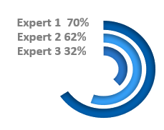


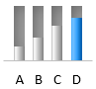


Alternative Data Stack to Measure Business performance
In addition to company financials, array of alternate data sources can provide signal about a company
Analyst Reports
Internal Assessment
To evaluate the consensus of investment analyst on recommendation on the stock like to buy / sell / hold stock etc. e.g. :Financial Times , Morning star,
Measure employees review about the company & their management. E.g. : Glassdoor, Indeed, Comparably
Revenue & Cost Drivers
Quality
Company Characteristics
Measure the effect of external perception on company’s revenue
e.g. : Google Analytics, Omniture, Statistica
Performance
Company
Analyze characteristics of organization like size etc. Eg: Linkedin, Crunchbase, Owler
Events
External Perception
Industry Outlook
Understand the quality of the company using external social data e.g., Yelp, Twitter, Facebook
Understand the Industry forecasts by market research firms & industry bodies
e.g. : Mckenize , Deloitte,BCG
Company Events
News A
Focus on detecting business critical events within News text & classify them into pre-defined categories
E.g. : M&A’s, New Product Launch , Layoff
News B
News C
Political & Social environment
Economic & Legal environment
Evaluate political & sociological factors situation within country that can affect the trends of the Industry/market
e.g.: Brexit, Trade relations
Evaluate Economic & legal policies of the across industry, country etc. which can change
e.g.: GDPR guidelines, IMF forecast,
Notes:
https://alternativedata.org/alternative-data/
https://scialert.net/fulltextmobile/?doi=rjbm.2014.89.103
https://visionedgemarketing.com/non-financial-metrics/
https://blog.ongig.com/employer-branding/the-top-5-sites-for-employer-reviews-ratings

Slide 5

Analyst Reports
To evaluate the consensus of investment analyst on recommendation on the stock like to buy / sell / hold stock etc. e.g. :Financial Times , Morning star,
Revenue & Cost Drivers
Measure the effect of external perception on company’s revenue
e.g. : Google Analytics, Omniture, Statistica
Industry Outlook
Understand the Industry forecasts by market research firms & industry bodies
e.g. : Mckenize , Deloitte,BCG

Slide 6



Internal Assessment
Measure employees review about the company & their management.
E.g. : Glassdoor, Indeed, Comparably
Company Characteristics
Analyze characteristics of organization like size etc.
Eg: Linkedin, Crunchbase, Owler
External Perception
Understand the quality of the company using external social data.
Eg., Yelp, Twitter, Facebook

Slide 7
Company Events
News A
Focus on detecting business critical events within News text & classify them into pre-defined categories
E.g. : M&A’s, New Product Launch , Layoff
News B
News C
Political & Social environment
Evaluate political & sociological factors situation within country that can affect the trends of the Industry/market
e.g.: Brexit, Trade relations
Economic & Legal environment
Evaluate Economic & legal policies of the across industry, country etc. which can change
e.g.: GDPR guidelines, IMF forecast,

Slide 8
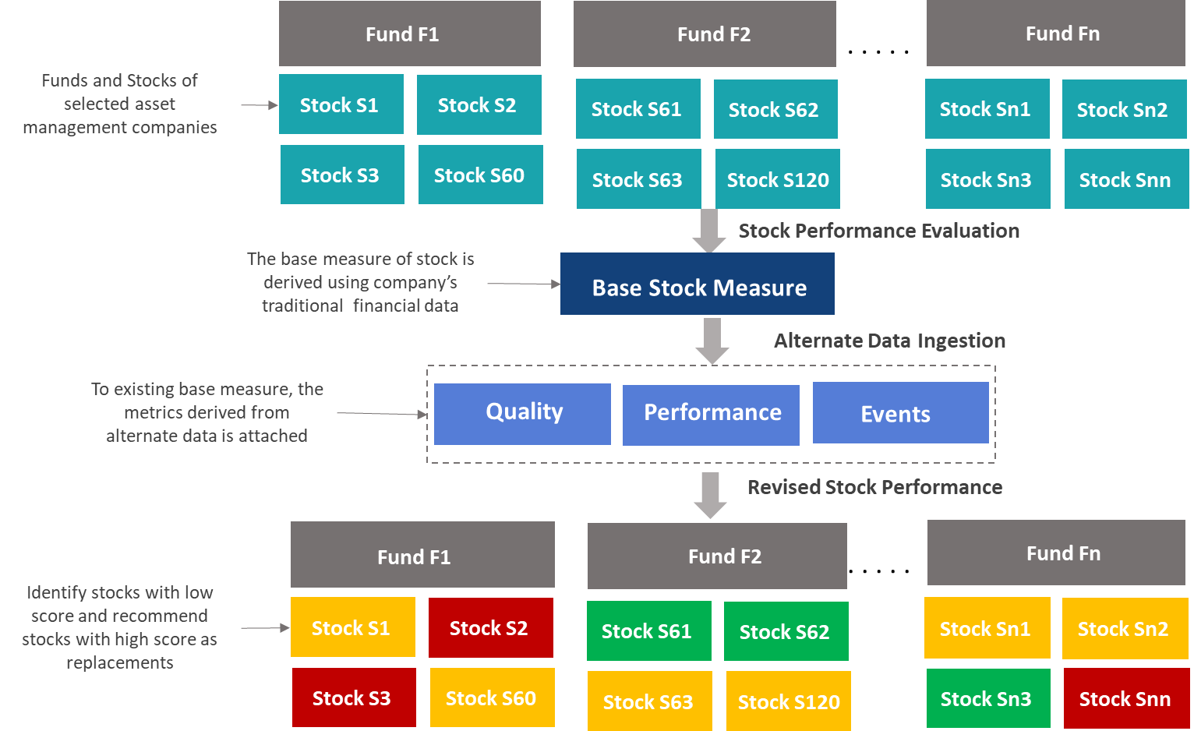
Stock Scoring Approach
Stock Score= Σ Base Measure +Σ Alternate Measure
Base Measure: Mean value of key stock performance indicators | Alternate measure: Mean of weighted alternate performance indicators
To each stock , the “Base Measure” is coupled with its “Alternate performance measure“ and given a score between 0 & 100.
This score is relative measure i.e. score can be used as measure to compare between different stocks at either overall or metric level.
The weight assigned to each factor of alternative data is customizable and helps in benchmarking companies .
For e.g.: If highest weight is assigned to Quality of company , the stock score explains how the quality of company as a factor has changed the stocks outlook
Positive Trend
Neutral Trend
Negative Trend

Slide 9
Sample Scoring Methodology for a Stock
Base Measure
Quality (Weight=0.40)
Events (Weight=0.60)
Abiomed Inc
Heico Corp
Abiomed Inc
Heico Corp
Abiomed Inc
Heico Corp
Data Extraction & Integration
Market_cap : 12.66 Bn
Market_cap : 9.52 bn
Glassdoor rating :3.8
Glassdoor rating : 3.8
Positive Events : 31
Positive Events : 47
P/E (ttm) : 63.19
P/E : 40.62
CEO approval rating :87 %
CEO approval rating : 84 %
Neutral Events : 33
Neutral Events : 41
1 Yr change : 46.67%
1 Yr change : 19.45%
Recommend to friend :75%
Recommend to friend : 59%
Negative Events : 36
Negative Events : 12
Data
Normalization
Market_cap :2.86
Market_cap : 1.89
Glassdoor rating :0.55
Glassdoor rating : 0.55
Positive Events : 0.31
Positive Events : 0.47
P/E : 0.20
P/E : -0.16
CEO approval rating :0.30
CEO approval rating : 0.12
Neutral Events : 0.33
Neutral Events : 0.41
1 Yr change : 1.34
1 Yr change : 0.59
Recommend to friend :0.46
Recommend to friend : -0.46
Negative Events : 0.36
Negative Events : 0.12
Metric Score
Score : 0.73
Score : 0.61
Score : 0.60
Score : 0.56
Score : 0.28
Score : 0.76
Grade : AA
Grade : AA-
Grade : A+
Grade : A+
Grade : BBB+
Grade : AA
Stock | Base Measure | Alternate Measure | Final Score | Change
Abiomed Inc | 0.73 | (0.6 *0.4) + (0.28 *0.6)=0.41 | 0.57 | -21.91%
Heico Corp | 0.61 | (0.56 *0.4) + (0.76 *0.6)=0.68 | 0.65 | 6.56%
By giving preference to company events and supplementing existing base measure with alternate data, the investment manager would be better informed while planning their investment between Heico corp & Abiomed Inc
Sample Positive Events :
Wall Street sell-side analysts are projecting HEICO Corporation (NYSE:HEI) to grow at an accelerated rate over the next 5 years. Brokerage firms are looking for ..
Sample Negative Events :
Heico Cp Cl A (HEI-A) shares are being watched closely by traders as the Awesome Oscillator signal is revealing a downward trend building over the past five..
*Factors showed for illustration purpose

Slide 10








Pilot : Analysis & Methodology
The pilot analysis consisted of 54 stocks split between two funds namely “ Standard Life Investments Global Smaller Companies Fund Institutional (23)“ &” Baillie Gifford Global Discovery Fund Accumulation (31) ”.
Base
Measure
Data Scraping
Entity Extraction
Standardization
Normalization
Base Measure
Stock Performance
Stock
Performance
Scoring
Algorithm
ΣBase Measure
+
ΣAlternate Measure
Internal & External Perception
Alternate Data
Quality Score
Performance Score
Event Score
Alternate Measure
Company events
Data Extraction & Integration
Fund Scoring
Evaluation & Inference
Relevant information from shortlisted data sources is extracted using custom web scrapers and advanced pattern matching algorithms.
For a given company each variable is given a score between 0-1 in relative to the other companies in the fund. This score is assigned basis the percentile range of its z score
Mean of all the variables under a metric is taken to get metric level score.
Each metric is assigned a weight & then summed up to get a company level alternate score
Data is normalized using Z score normalization to preserve the range (max & min) and introduce the dispersion of the series (standard deviation / variance)
For e.g. z score value > 90th percentile is assigned a score of 0.9 & z score value > 80th but <90th percentile is assigned a score of 0.8 and so on.
This score is then supplemented with existing base measure to get overall stock score
Period : Data collected as on 24th December 2018

Slide 11
Pilot : Inference & Validation
Stock Scoring Model Output
Input data |  |  |  |  |  |  | Base Measure |  | Alternate Score |  | Stock Score |  |  | Grade
Investment Company | Company | Market Value (£ '000) | Shareholding | % of total assets | Country | Category | Performance | Rank | Score | Rank | Score | %Change | Rank | Base Measure | Stock Score
Baillie Gifford | Renishaw PLC | 5265 | 111682 | 1.29 | United Kingdom | business and industry | 0.47 | 33 | 0.71 | 12 | 0.59 | 25.53 | 24 | A | A+
ASI | Teleperformance SE | 38776 | 263167 | 2.67 | France | business and industry | 0.52 | 23 | 0.71 | 12 | 0.62 | 19.23 | 15 | A+ | AA-
Baillie Gifford | Ricardo PLC | 677 | 71158 | 0.17 | United Kingdom | business and industry | 0.36 | 46 | 0.73 | 10 | 0.55 | 52.78 | 33 | A- | A+
Model Insights
Model Validation Framework
Stocks of Food and Drink sector are performing best
New Zealand seems to be best bet for investment .
Average base measure of stocks under ASI in 1.2x of Biliford .But supplementing this with alternate measure reduce this to 1.1x (This decrease is primarily driven by the negative sentiment around companies of ASI fund in china &USA.)
Average performance of Japanese companies in Baillie Gifford fund is 1.3x that of ASI companies located in Japan
As the data points collected for the pilot were not exhaustive , validation of the final output is little challenging. But the generic framework to validate the stock score is as follows
For a given period track required information and calculate the “Stock score“
Monitor the stock over a defined period & compare with predicted suggestion
Infer results from the stock score to “buy/sell/hold“ stock
** Please refer excel for complete result of scoring model
** The insights are basis assumptions and weights assigned by LatentView

Slide 12
Thank you

Slide 13
Appendix

Slide 14















Architecture of Social Insights Platform
Visualization Layer
Algorithms & Techniques
N-gram, NMF, Clustering, Organic Conversation Extraction, Graph Network Analysis, PI Framework etc.
Data Processing
Layer
Rules Engine
Corpus
Regular Expressions, Boolean Text Search etc.
Spam Removal
Data Cleansing
Promos, Deals, Offers etc.
Stemming, Stop-words removal
Consolidated Data Mart
API Calls
Web Scraping
Data Sourcing Tool
Instagram
API
Data Extraction
Layer
Twitter Open API
Selenium

Slide 15

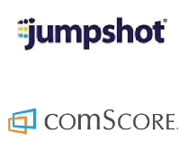
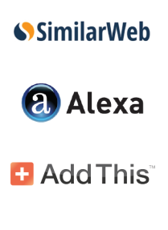





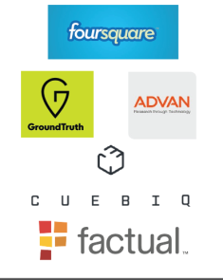
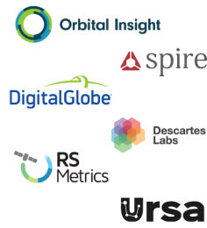
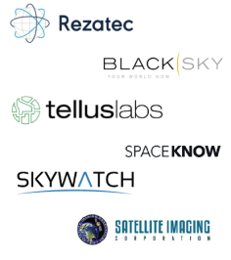
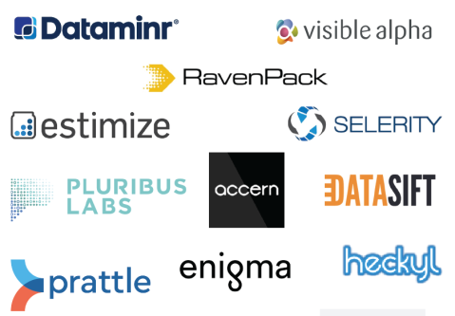
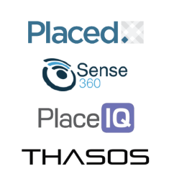



Alternative Data sources
Social Media
Web Traffic
Industry Reports
New Outlets
Reviews
Geo Location
Satellite
Sentiment/Public Data

Slide 16




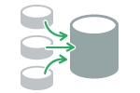







Latentview Solution Framework
LatentView’s approach for supplementing traditional investment decisions with alternate data is a four step process:
Defining Business Metrics
Data Extraction & Integration
Comapny Scoring Model
Evaluation & Inference
Source Identification
Data Integration
Feature Engineering
Model Inference
Defining Business objectives
Data Extraction
Data Normalization & Standardization
Competitor benchmarking
Data Source Filtering
Data Transformation
Model Iteration & Validation
Business Insights
Notes:
16

Slide 17
Next Steps
To finalize the type of funds for which model would be developed.
Identifying all possible sources of alternative data which can help in decision making.
Finalize key variables & metrics across each data source which are critical to business.
To fine tune to the scoring model in collaboration with ASI key stakeholders.
To gradually shift towards Machine learning based scoring model
To automate the data extraction to scoring process for shortlisted sources and funds

Slide 18







Future Scope
Some of the key features which can be built on top of the existing solution
Recommendation
Customization
Help investment firms create a basket of the best companies for a given fund
Customize the data sources and scoring algorithm based on the industry, geography, company size etc
New Sources
Multilingual
To include additional sources/websites and create more metrics to understand the company/stock
Train the model to identify events from multiple languages.
Cloud based Platform
Risk Detection
To develop a web based platform for quick and easy access of information across the organization
Identify risk through user-configurable reports that incorporate data from different data sets
Notes:
General tool for full life cycle:
Contract Creation– Drafting a contract from a template;
Contract Analysis– Analysing the contents of the contract to help you simplify it and understand the good, bad and ugly; Near-duplicate Identification/Grouping, Repeated Content Filtering
Contract Management– Understanding the business aspects of a legal document and putting it into action.
Financial Services :
Fraud Detection – Money Laundering, Health Care Fraud, Insurance Fraud, Loan Fraud : understanding the red flags of fraud in the industry and then searching the data for those red flags. The red flags vary by industry and use case, and the unstructured content certainly varies, but the underlying concept is the same: Insight is using machine learning to find anomalies of interest.
Loan Application Processes – Mortgage, Education, Commercial and Industrial Loans : Machine Learning can help lenders automate the process of validating borrower-provided documentation against third party sources. This enables them to assess risk and improve loan-level decision making, by using machine learning algorithms to analyze the data for accuracy, consistency, and completeness.
Human Resources – Workforce Planning, Candidate Profiling and Human Capital Management : Every company has lot of HR files, to the tune of millions and millions of pages. There is value in this data. ML models can crawl personnel files — which include recruiting documents such as applications and resumes, records related to job offers and promotions, compensation information, policy acknowledgments, disciplinary notices, and termination records – and use the data to make recommendations related to hiring (including background investigations), workforce optimization, and budgetary planning. ML Models can help understand the trends related to attrition and help plan ahead.
Government & Law agencies Optimization – Departmental Workflow and Data Analysis : different government agencies supporting its citizens, everything from police and fire rescue to health and human services to multiple court systems. All of these departments collect and generate a massive amount of documentation. Family services departments, for example, could leverage to crawl their historical record of domestic violence cases to determine ways to optimize their counseling and support group services. The police department could take it a step further and analyze unstructured text on every police report ever filed and correlate it with crime records to build a predictive model for optimizing their officer dispatch plans.
Healthcare & Life science – Real-time Alerting, Predictive Analytics, and Administrative Optimization : As the behemoth healthcare industry continues its shift from a fee-for-service model to value-based-case, successful population health management is largely dependent on the data it generates. Even with standardized data formats like HL7, vast amounts of unstructured text still lurk in the data. From encounter notes to pathology reports and hospital discharge summaries, Insight can be used to put structure to the unstructured blocks of text that are found on these types of content. With more structure comes slew of benefits: improved real-time alerting on individual patient’s health, predictive analytics related to cohort identification and treatment strategies, and optimization of the administrative functions of hospitals.
Manufacturing, IT hardware & Software : Procurement , Vendor Management , Digitization of all records in supply chain, Project Monitoring
Legal:
Due diligence – Litigators perform due diligence with the help of AI tools to uncover background information. We’ve decided to include contract review, legal research and electronic discovery in this section.
Prediction technology – An AI software generates results that forecast litigation outcome.
Legal analytics – Lawyers can use data points from past case law, win/loss rates and a judge’s history to be used for trends and patterns.
Document automation – Law firms use software templates to create filled out documents based on data input.
Intellectual property – AI tools guide lawyers in analyzing large IP portfolios and drawing insights from the content.
Electronic billing – Lawyers’ billable hours are computed automatically.
Media & entertainment
read manuscripts/lyrics to find duplicates / recommendations etc
create summaries
Read music notes from images and save it

Slide 19
Pilot - Data Preparation & Exploration
Data inconsistencies and issues treatment
Duplicate data observed was removed
Outliers were not excluded from the data set
Missing observations were treated in the following ways
Variables with less than 25 % coverage was removed from the analysis
Any data point for which data was not found in the website was left as is.
Data exclusions
Only those companies which had at least 60 % of all variables were considered for scoring .The pilot model had 42 variables across Quality(10), Performance(29) and Sentiment (3)
Only those companies which had at least 25 variables were considered in the model
Categorical variables were excluded from the pilot model.
Model Variables Across each data source
Quality
Performance
Events
Positive: uptrend in growth , new funding etc.
Negative: decline in growth , scandal, forgery etc.
Neutral : Anything else
Company Rating
CEO Rating
Website Rank
Bounce Rate
Avg. Page visit
Average Volume
Market Cap
Price
Shares Outstanding
net_margin_ttm
operating_margin_ttm
** Please refer excel for complete set of variables used

Slide 20
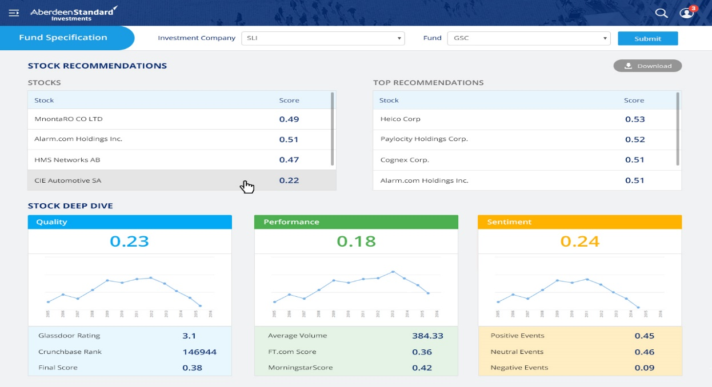
Sample UI of Web Interface

